Slide 1
Cognitive Analytics – Architecture and Evolution CSBA 3009

Slide 2
Architecture of Cognitive Computing
Cognitive computing is a kind of heterogeneous model that makes the working of computerized devices wholesome in all aspects making it capable of solving any and every kind of problem that a human brain, as well as a computer, could tackle.
The architecture of cognitive computing chips has Neurosynaptic cores that operate in parallel as nodes(neurons) that comprise the processor(cell body), data bus(axon) and memory(synapse).
Such nodes have been assigned specific weights and are fed with a large amount of data that ultimately interconnect with each other to perform tasks.
These chips keep on analyzing and learning from the data continuously.

Slide 3
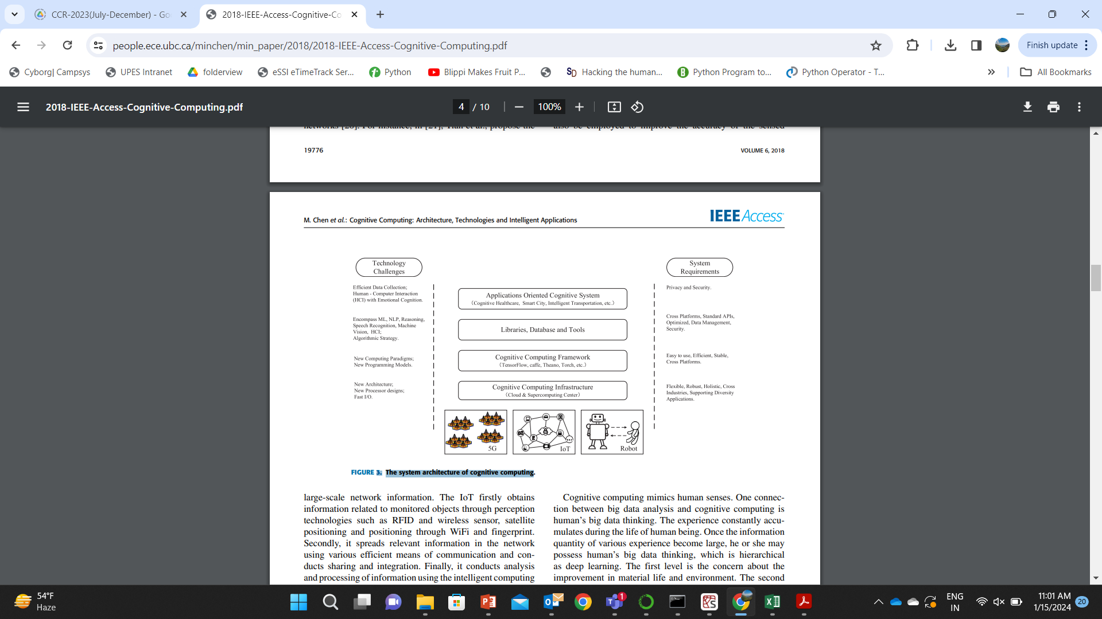
The system architecture of cognitive computing

Slide 4
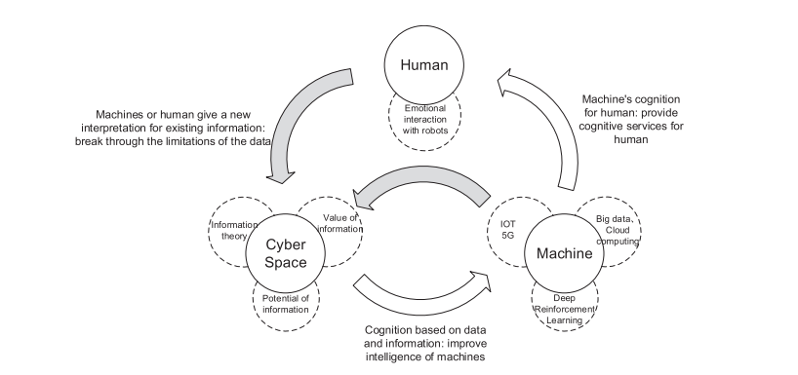
Human Centered Cognitive Cycle

Slide 5
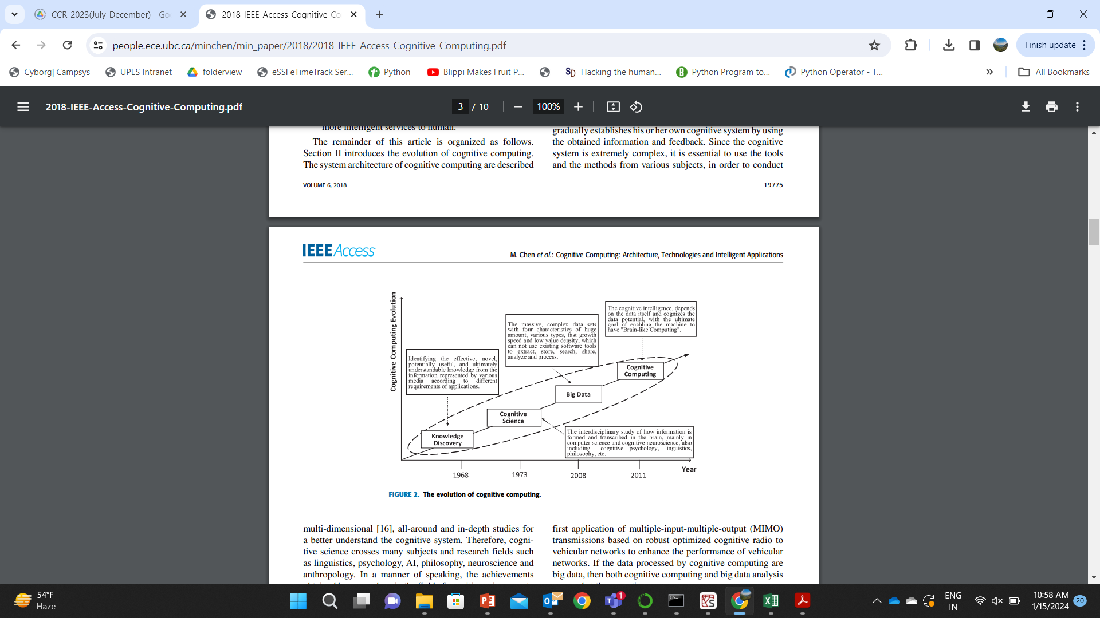
The evolution of cognitive computing

